Slide 1


Ansible for Real-World IT Ops: Configuration
Automating IT operations for efficient infrastructure management
Content:
Precedence of ansible configuration file.
Demo
Quiz
Mini Challenge
Notes:
---

Slide 2
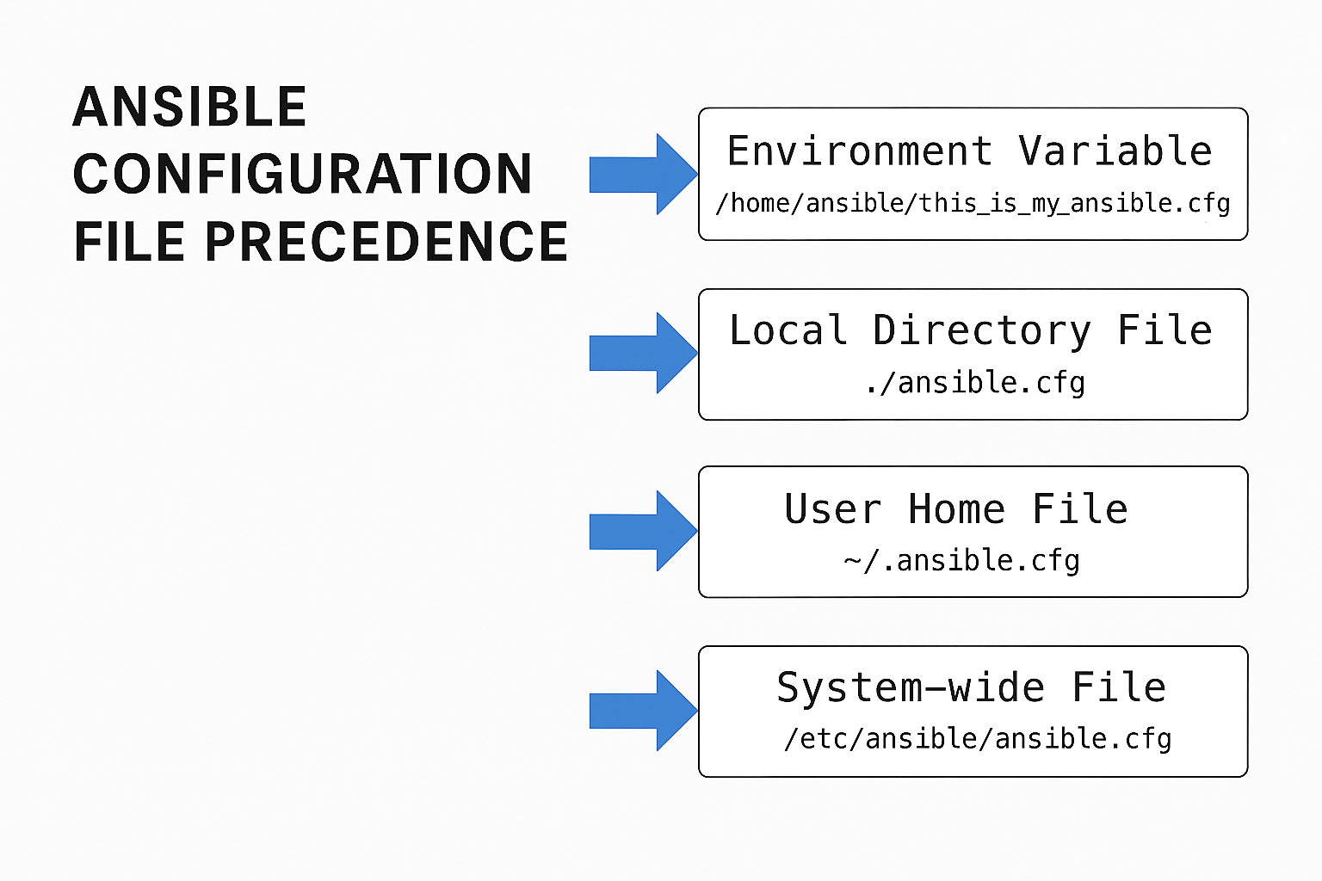
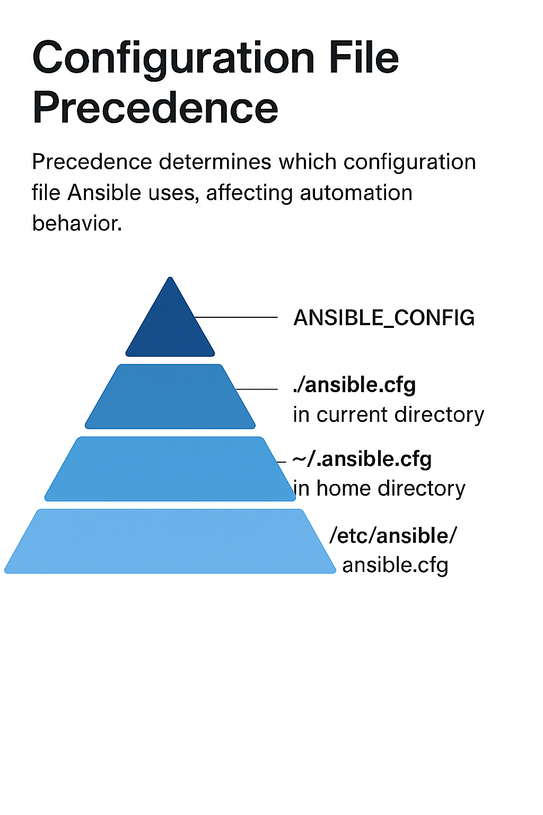
Ansible Configuration File Precedence

Slide 3

Live Demo Plan: ansible configuration
Creation and configuration of Environment Variable (ANSIBLE_CONFIG) – priority 1
Configuration file path should show customized configuration file path
Creation and configuration of Local Directory File (./ansible.cfg) – Priority 2
Ansible configuration file path should show local directory file.
Creation and configuration of User Home File (~/.ansible.cfg) – Priority 3.
Configuration file path should show User home file
Creation and configuration of System-wide File (/etc/ansible/ansible.cfg) – Priority 4.
Configuration file path should show system wide file path
Testing of fallback behavior

Slide 4
Quiz Section
Question | Answer | Explanation
Which configuration file is having the highest priority in Ansible? | ANSIBLE_CONFIG | It overrides all other configuration sources
What command shows which configuration file is Ansible Using? | ansible --version | The command displays the path to the active configuration file
Which configuration file is having the lowest priority? | /etc/ansible/ansible.cfg | It is the default system wide configuration and used only if no config files are found.
How to override all other configuration files in the current directory? | By setting the ANSIBLE_CONFIG environment variable | It is having the highest precedence among all configuration sources.
What is the default name of the configuration files in the current directory? | ansible.cfg | If present in the current working directory, it overrides system and home configuration files.
Which command disables host key checking ? | Add host_key_checking=false in the configuration file or set environment variable ANSIBLE_HOST_KEY_CHECKING=false | It prevents ssh prompt during automation.
What happens if multiple configuration files exist? | Ansible will choose the file with the higher precedence | The order is as below. 1. ANSIBLE_CONFIG 2. ansible.cfg 3. .ansible.cfg /etc/ansible/ansible.cfg

Slide 5
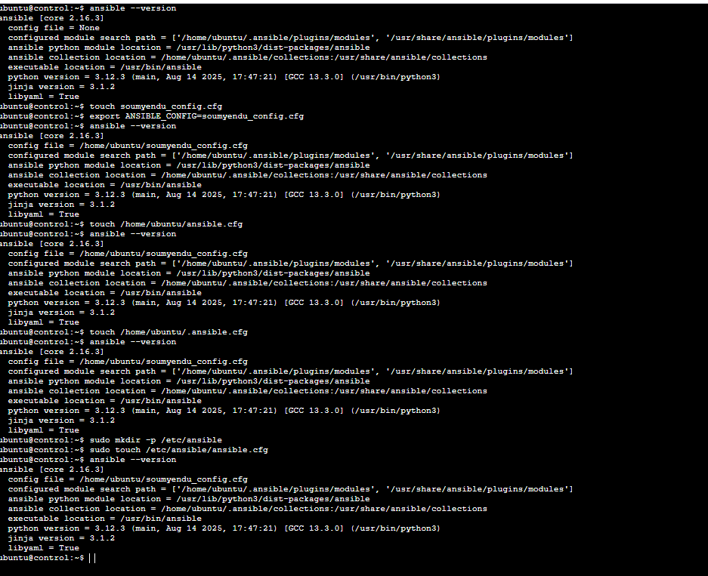
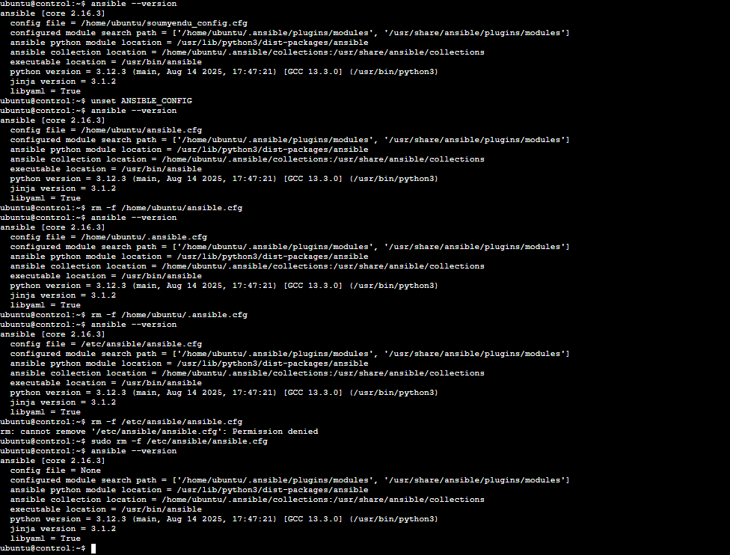
Hands-On challenge: ANSIBLE CONFIGURATION
Configuration File Precedence Test:
Create all four config files. Set ANSIBLE_CONFIG and observe behavior.
Remove each file one by one.
Rerun ansible --version
Creation of all 4 configuration files, it shows the precedence of ANSIBLE_CONFIG HAVING HIGHEST PRIORITY
Removing each config file one by one and running command ansible –version

Slide 6

What’s Next?
Discuss Ansible Architecture and Design using below
What is an inventory file and why is it critical ?

